Slide 1


Welcome to Surjay’s Birthday Party

Slide 2

Birthday Wishes
Happy birthday, cherished buddy. We wish you a happy and prosperous new year. Sending our finest wishes from team.

Slide 3

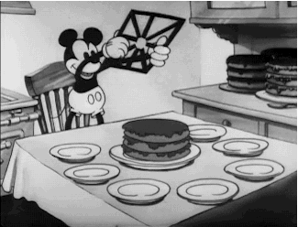

Slide 4

Some Iconic Moments of Surjay’s Life are Coming up Next
Me adding some Spices in it

Slide 5


“The story, names, characters and incidents portrayed in upcoming slides are real. It may cause emotional… damage… watch on your own risk”

Slide 6
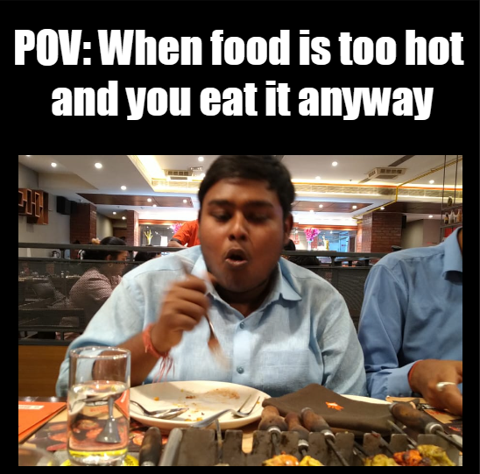

Slide 7
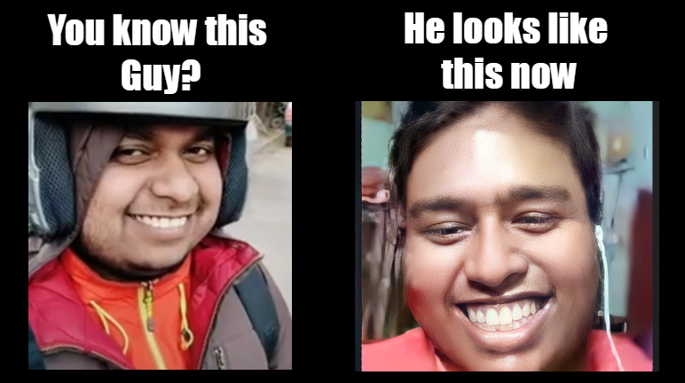

Slide 8
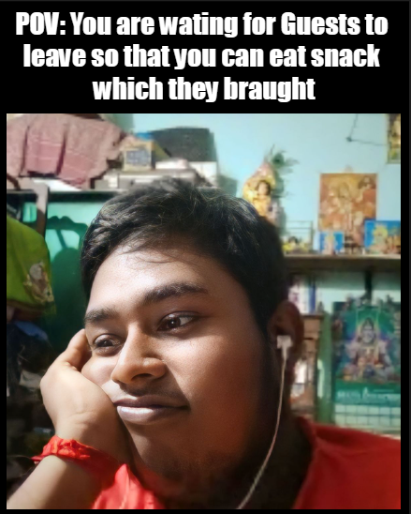

Slide 9
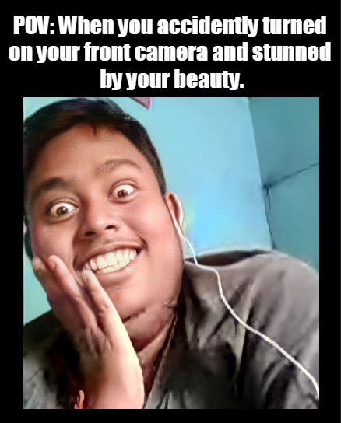

Slide 10
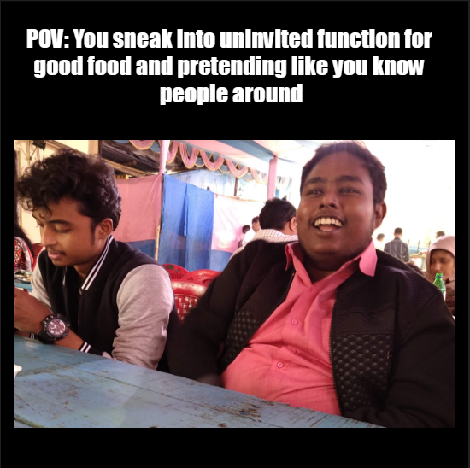

Slide 11


Slide 12


Slide 13
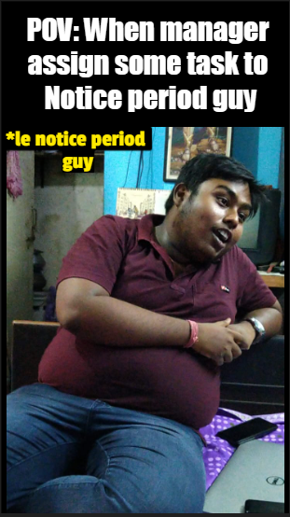

Slide 14
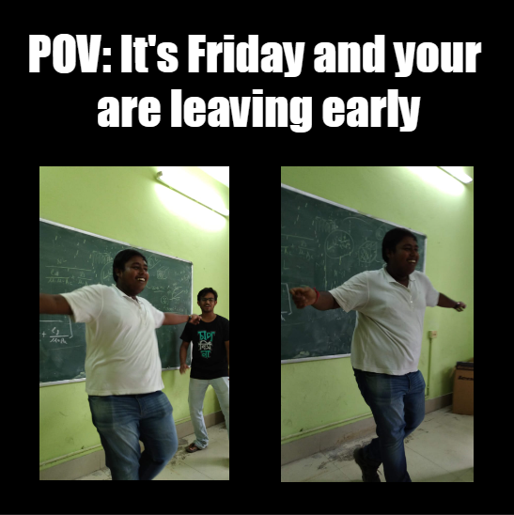

Slide 15
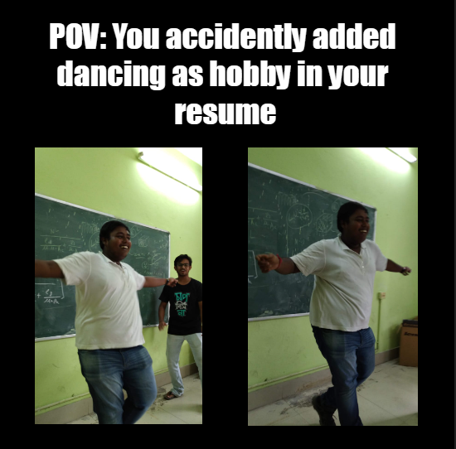

Slide 16
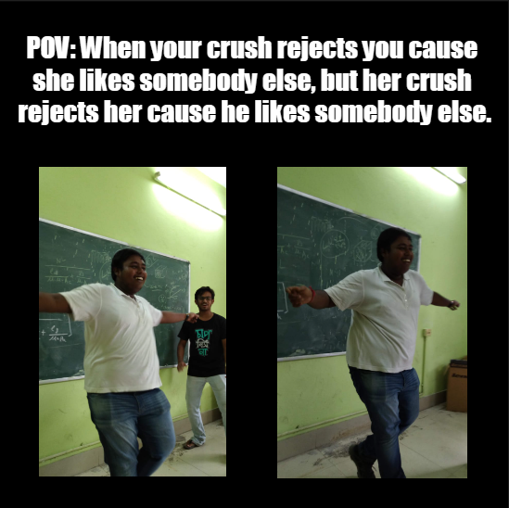

Slide 17
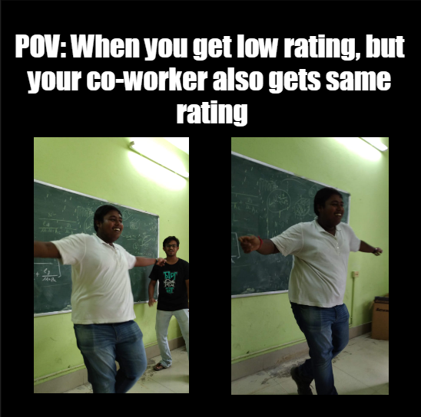

Slide 18


